Slide 1

Algorithmic Trading Strategies
Jelena Antić, Paulina Grnarova, Filip Hrisafov,
Vidor Kanalas, Miloš Stojanović, Alexios Voulemeneas

Slide 2
Outline
Motivation
Data
Strategies
Genetic Algorithm
Application Flow
Results
Conclusion

Slide 3

Motivation
Financial market extremely attractive, moves trillion dollars per year
Electronic limit order books have recently been introduced by almost all major stock exchanges
Limit order books represent large amount of electronic financial data that can be processed in order to exploit underlying patterns
Predict future prices by using a variety of algorithms
Use of machine learning techniques and pattern recognition to find a profitable solution
Notes:
In the last few years, electronic limit order books, which collect incoming limit orders and automatically match market orders against the best available limit order have been introduced by almost all major stock exchanges.
Limit order books represents a large amount of electronic financial data that can be stored and processed in order to exploit underlying patterns. Financial institutions are using this data to create advantage for them on the market. One of the applications is automated trading strategies that use these patterns to trade with competitive edge.
The financial market is extremely attractive since it moves trillion dollars per year. Several
investors have been investigating a way to predict future prices by using a variety of algorithms that
use fundamental analysis and / or technical analysis. These tools are used by either professional
speculators or amateurs to analyze the price movement of some financial assets. The use of genetic
algorithms, neural networks, genetic programming combined with these tools in an attempt to find a
profitable solution is very common.

Slide 4
Data
Microsoft Order Book Data
Time | Ticker | Order | T | Shares | Price | MPID | X
14400016 | MSFT | 13264 | B | 100 | 10000 |  | Q
Type of column | Description
Timestamp | Miliseconds after midnight
Ticker | Stock identifier
Order | Order ID
T | Message type (buy, sell, delete, cancel etc.)
Shares | Number of shares in order
Price | Price of the order
MPID | ID of the market participant issuing the order

Slide 5


Strategies
Market psychology
Wilder’s stock parameters
Trend direction
Trend strength
Patterns
Double Bottom
Double Top
Rectangle
Head and Shoulders

Slide 6
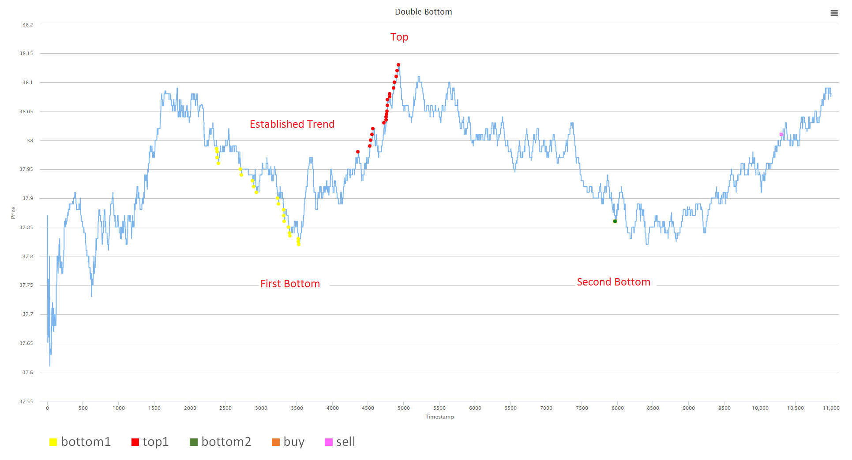
Double Bottom

Slide 7
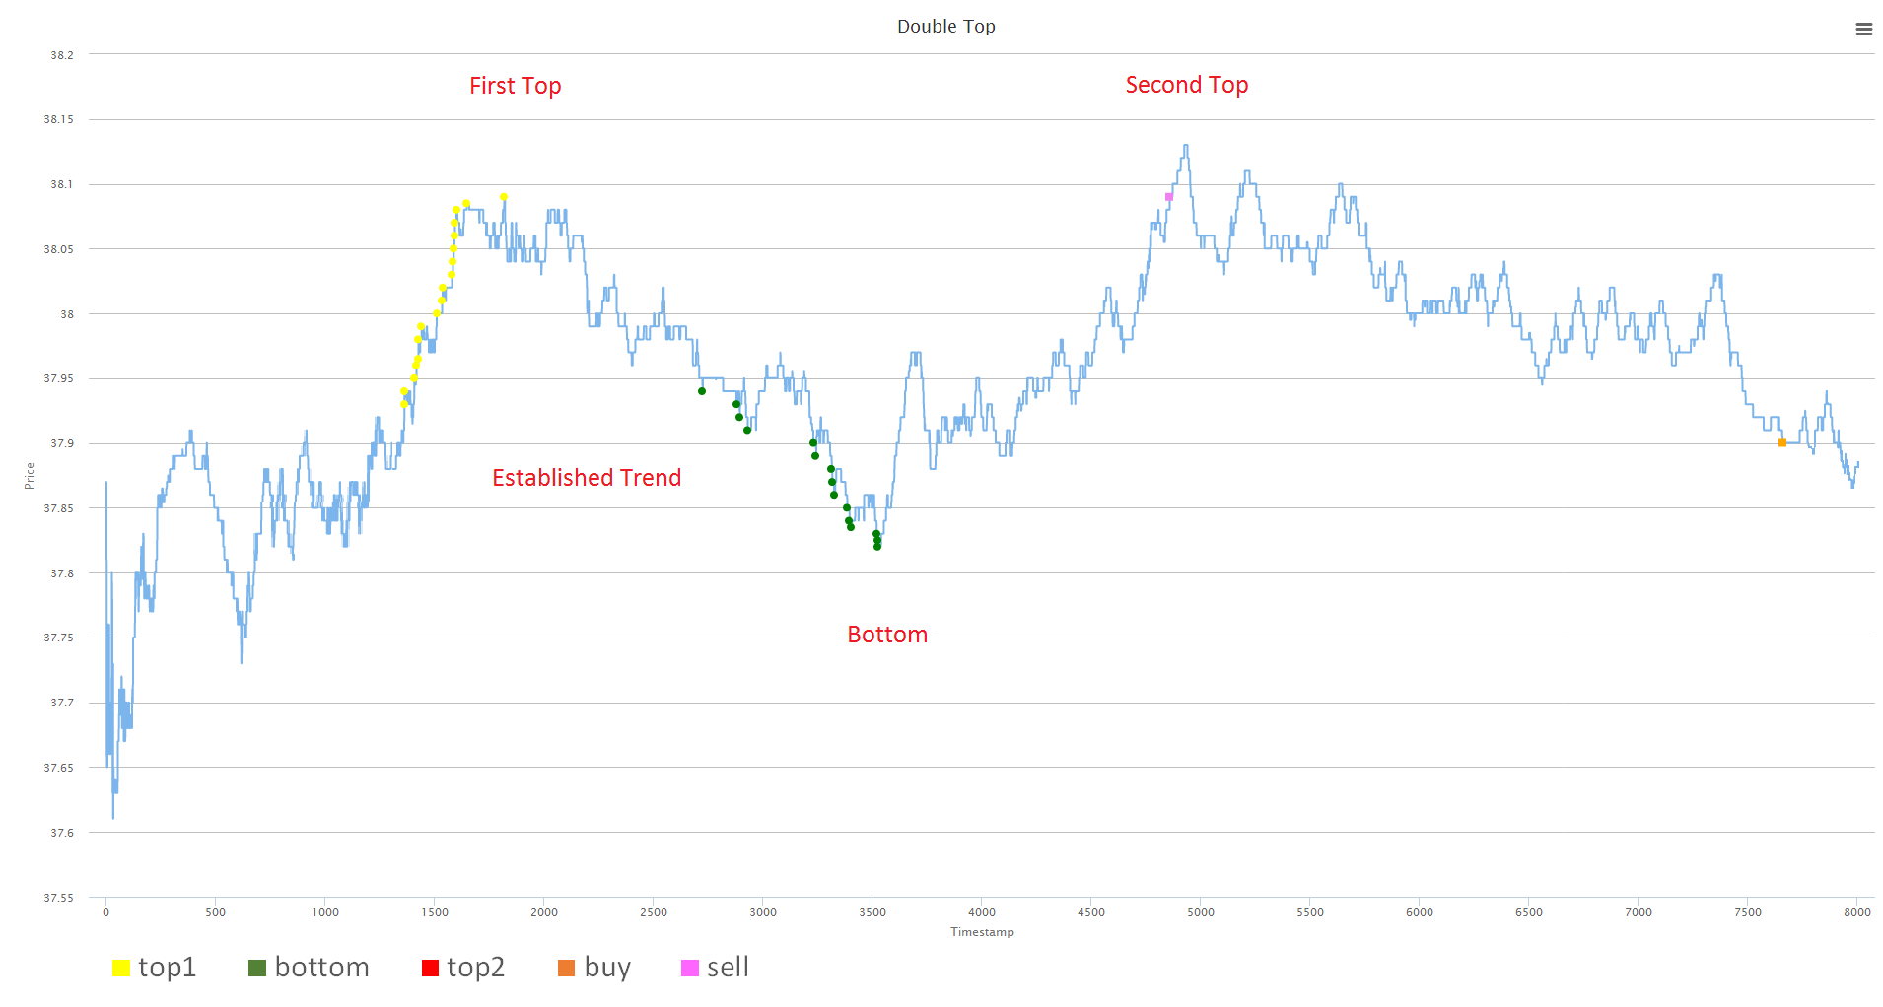
Double Top

Slide 8
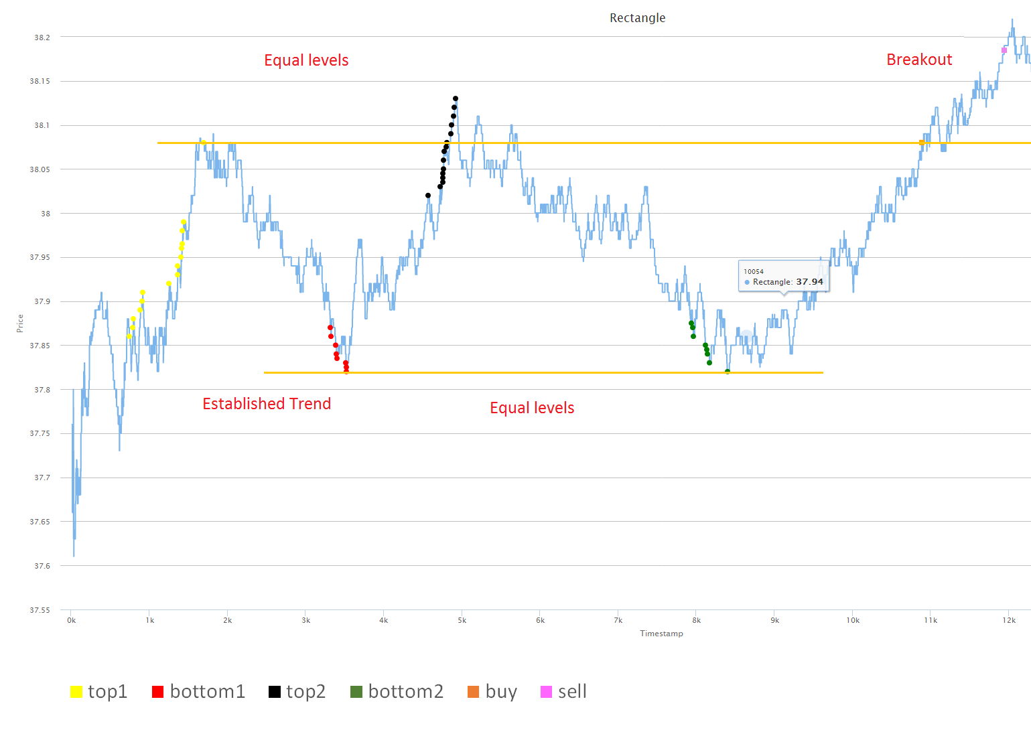
Rectangle

Slide 9
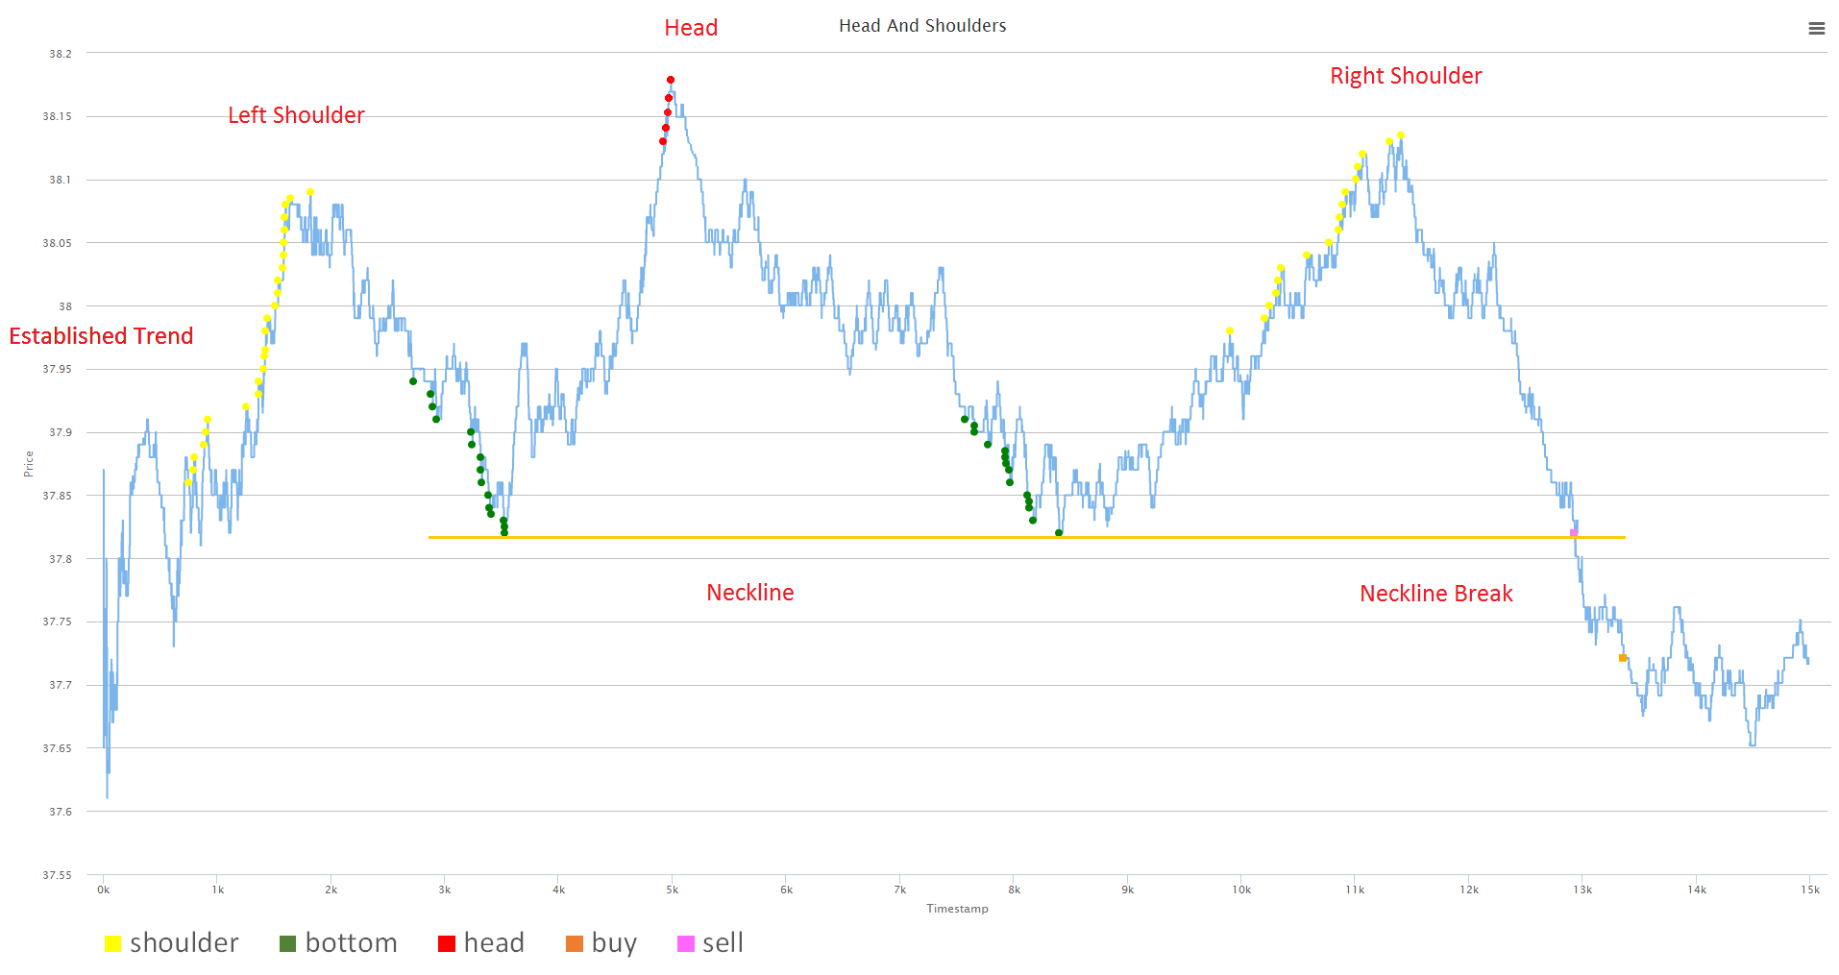
Head and Shoulders

Slide 10
Genetic Algorithm
Machine learning algorithm
Great success in the identification of graphical patterns
Based on the principles of Darwinist evolution
Fitness function to evaluate the individuals
Selection – good specimens reproduce more often
Crossover – both parents pass on characteristics
Mutation – child can be born with new characteristics

Slide 11
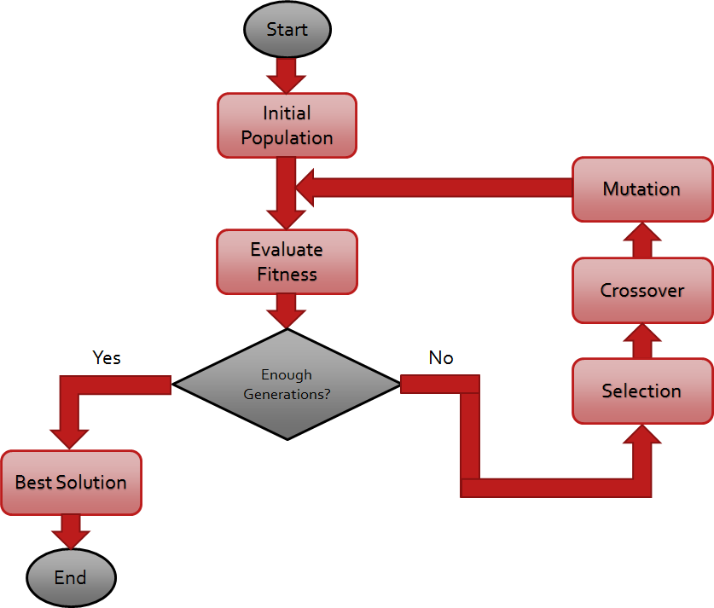
Genetic Algorithm

Slide 12


Double Bottom Chromosome

Slide 13
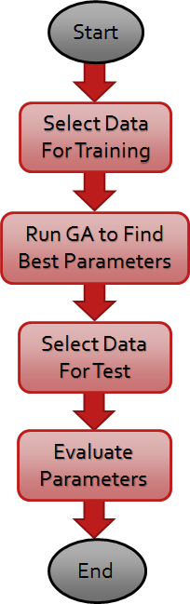
Application Flow
30 days for training
12 days for test
Starting amount of money 3000$

Slide 14
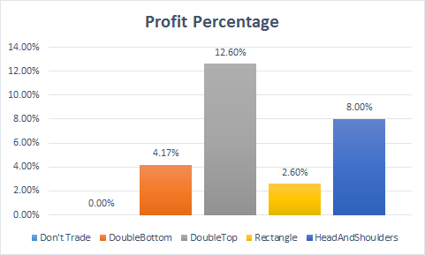
Results

Slide 15
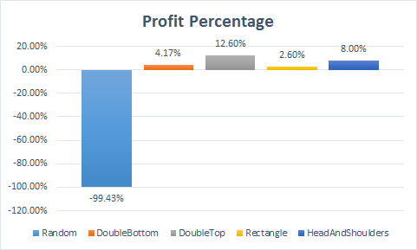
Results

Slide 16
Conclusion
All strategies performed well in predicting the future trend
Profit obtained for each of the 4 implemented strategies
The highest profit is about 13% of the starting amount of money
Encouraging results for future improvement of the project

